Slide 1
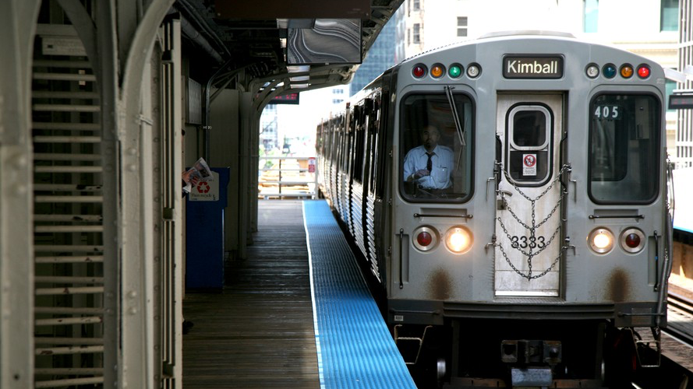
SECURITY ON PUBLIC TRANSPORTATION IN CHICAGO
GROUP 6 | Jainam Mehta, Julian Kleindiek, Lola Johnston, Peter Eusebio

Slide 2
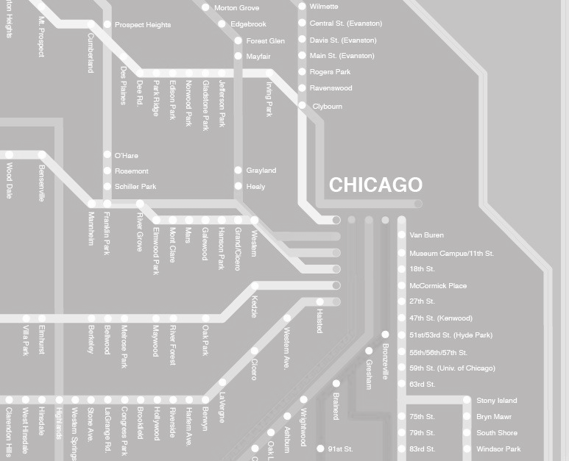
EXECUTIVE SUMMARY
Crime on public transportation and in its surroundings is severe in Chicago, posing a threat to consumers and a challenge to law enforcement authorities
Many of the UChicago students are frequently using public transportation and hence affected by this issue
The objective of this project is to discover patterns in the occurrence of crime on and around public transportation
The insights derived will be used to:
Give consumers guidance on the risk related to taking the route that they are anticipating to take
Help authorities understand what factors contribute to spikes in crime and give recommendations on how to provide more safety on public transportation

Slide 3
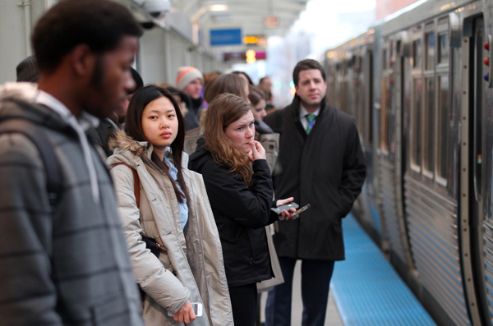
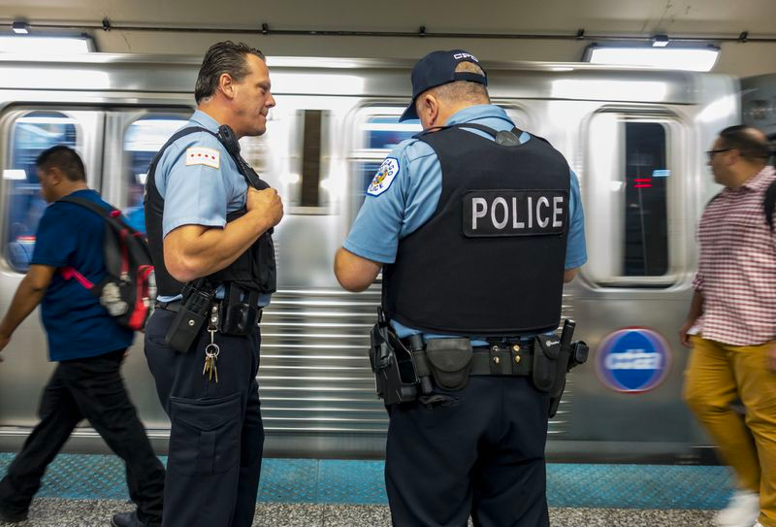
BUSINESS USE CASE
Exposed to crime on public transportation
Lack of information on the safety of taking public transportation
Avoiding dangerous routes as a tourist
Trade off between safety and cost for transportation
Lack of safer options
Chicago’s reputation as one of the most dangerous cities in the US
Inability to ensure safety and prevent crime on public transportation
Lack of information on how external factors influence crime on public transportation
Lack of information on where to increase staffing and presence
Any person using public transportation in Chicago, including commuters, residents and tourists
Any organization responsible for providing safety on public transportation in Chicago e.g. CPD, private security

Slide 4
SOLUTION AND IMPACT
Provide insights into the risk level of using a given means of public transportation at a given point in time
Provide greater transparency on the safety of different public transport options
Provide insights into how to increase safety on public transportation by unveiling dominant crime patterns
Provide predictive information on when to anticipate heightened crime, and help improve staffing efficiency
CONSUMER
AUTHORITIES

Slide 5



DATA PROCESSING AND PREPARATION
DATA SOURCES
PREPARATION
DATABASE
ANALYSIS
Crime (updated daily)
CTA_BusStops (static)
CTA_TrainStops (static)
Weather (updated daily)
Holidays (https://www.federalpay.org/holidays)
CityGrid (static)
API for daily refresh
Download, transform, clean
Risk Score Development
Data Management in CloudSQL
API for daily refresh
Data Visualization
Download and clean
Grid generation, Grid ID assignment

Slide 6
PLATFORM CONSIDERATIONS
PREPARATION
DATABASE
VISUALIZATION
Alternatives: OpenRefine
Programmatic tool compared to OpenRefine which requires GUI
Wider availability of packages (pandas, numpy)
Ability to directly interface with SQL server
Alternatives: AWS, Azure
Greater familiarity with GCP compared to other platforms
Ease of access through shell directly within Chrome
Availability of free credits
Alternatives: PowerBI, Metabase
Better performance on high volume datasets
PowerBI workspace has a limit of 10GB data
Greater flexibility in connecting with database sources and servers

Slide 7
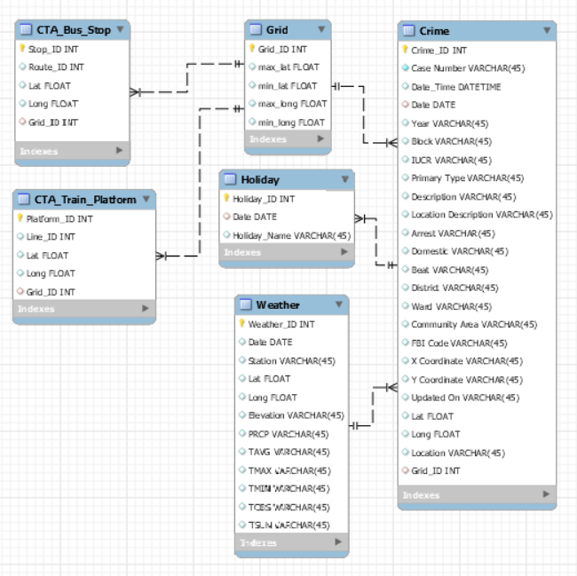
ENHANCED ENTITY RELATIONSHIP MODEL

Slide 8
TABLE OF CONTENTS
Executive Summary
Business Case
Data Sources
Additional Considerations
Tools

Slide 9
TARGET GROUPS
CONSUMER
AUTHORITIES
Any person using public transportation in Chicago, including commuters, residents and tourists
Any organization responsible for providing safety on public transportation in Chicago e.g. CPD, private security
Notes:
<Insert Demographics>
<Insert Psychographics>
Age/Lifestyle/Occupation/Income

Slide 10
PAIN POINTS
Exposed to crime on public transportation
Lack of information on the safety of taking public transportation
Avoiding dangerous routes as a tourist
Trade off between safety and cost for transportation
Lack of safer options
Chicago’s reputation as one of the most dangerous cities in the US
Inability to ensure safety and prevent crime on public transportation
Lack of information on how external factors influence crime on public transportation
Lack of information on where to increase staffing and presence.
CONSUMER
AUTHORITIES
Notes:
<Insert Demographics>
<Insert Psychographics>
Age/Lifestyle/Occupation/Income

Slide 11
SOLUTION AND IMPACT
Provide insights into the risk level of using a given means of public transportation at a given point in time
Provide greater transparency on the safety of different public transport options
Provide insights into how to increase safety on public transportation by unveiling dominant crime patterns
Provide predictive information on when to anticipate heightened crime, and help improve staffing efficiency
CONSUMER
AUTHORITIES
Notes:
<Insert Demographics>
<Insert Psychographics>
Age/Lifestyle/Occupation/Income

Slide 12




DATA SOURCES
Chicago crime reports
Location descriptions
Geocodes
CTA routes
CTA ridership statistics
Weather
Events
U.S. Office of Personnel Management

Slide 13
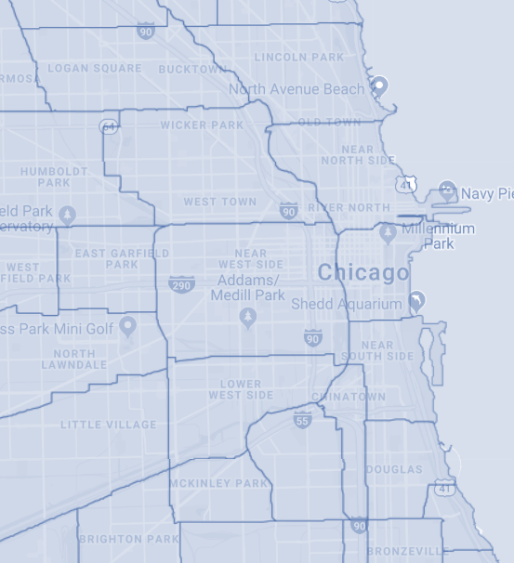
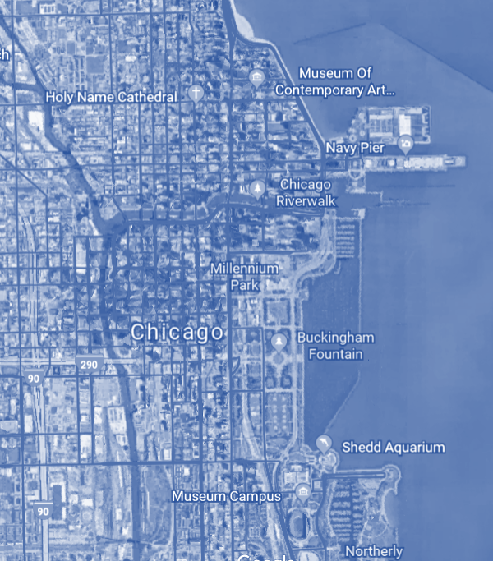
METHODOLOGY
Match crime geocodes to districts
Divide each CTA route into districts passed through
Use crime statistics by district to weigh risk on routes and at stops

Slide 14

TOOLS
Used for Data Extraction, Data Preparation and Data Analysis
Used for Data Storage
Used for Data Visualization
Used for Data Normalization, Database Design and Data Manipulation

